Slide 1
Chapters 4(B) – 6 Review

Slide 2
Chapters 4 - 6
4. (Part B) Techniques of Circuit Analysis
5. Operational Amplifiers
6. Inductance, Capacitance and Mutual Inductance

Slide 3
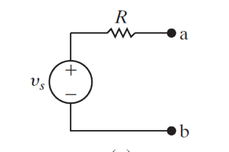
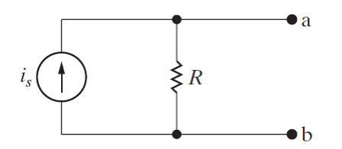
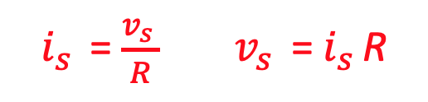
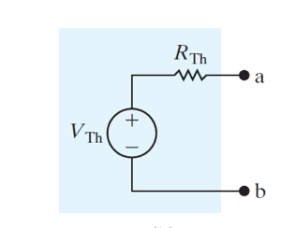
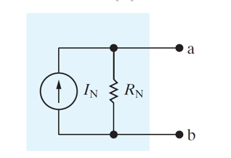


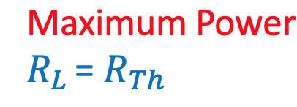
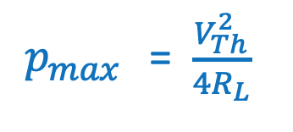
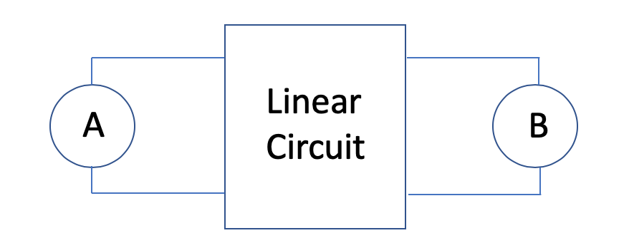
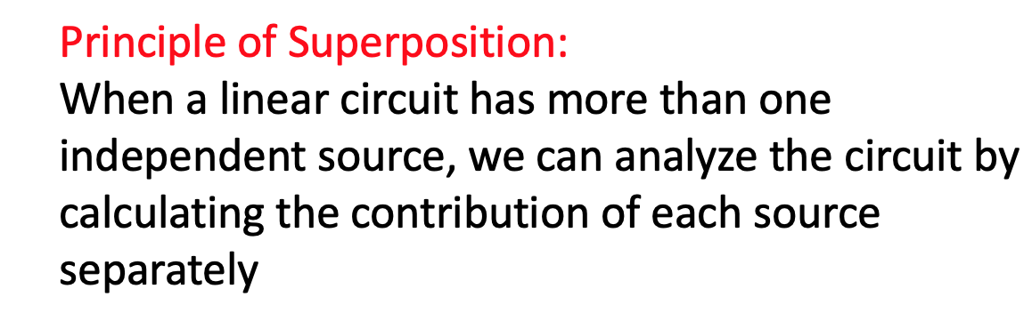
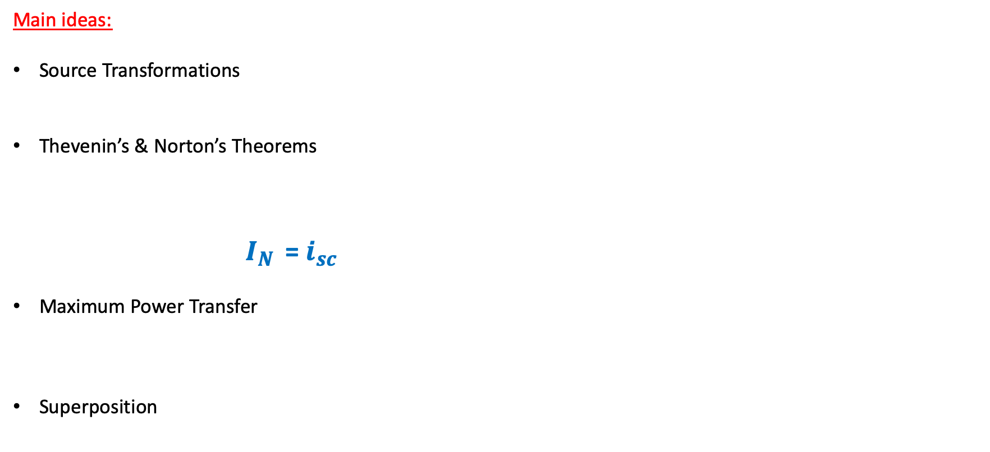
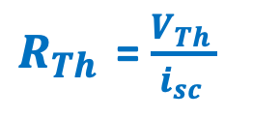
Chapter 4 (B) – Techniques of Circuit Analysis
Main ideas:
Source Transformations
Thevenin’s & Norton’s Theorems
${ I}_{N }$ = $i_{sc }$
Maximum Power Transfer
Superposition
$R_{Th }$ = $\frac{V_{Th }}{i_{sc }}$

Slide 4
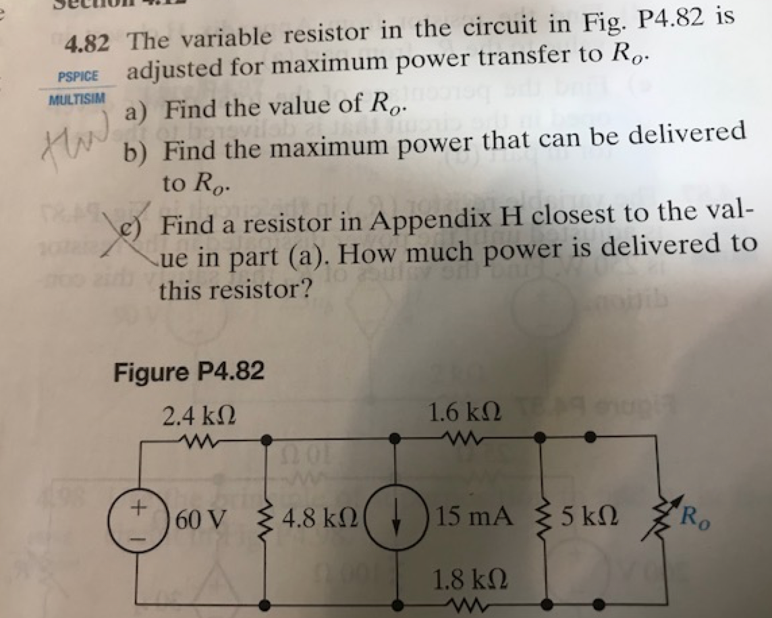
Chapter 4 (B) – Techniques of Circuit Analysis

Slide 5
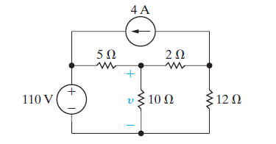
Chapter 4 (B) – Techniques of Circuit Analysis: Superposition
Problem 4.92
Questions:
Find voltage v
Find power in the 10 Ω resistor

Slide 6
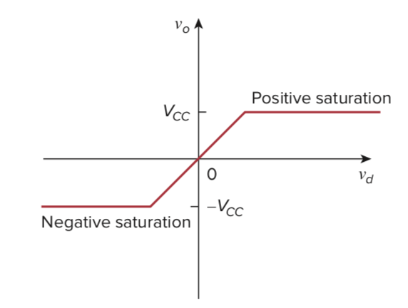
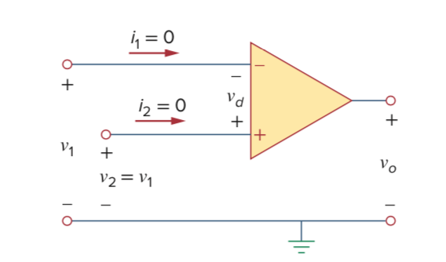
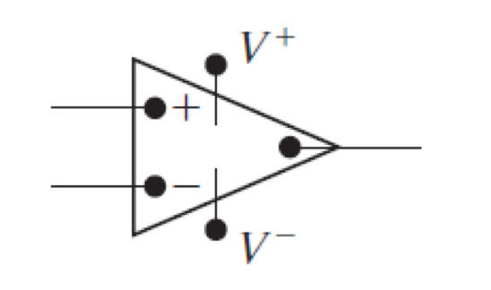
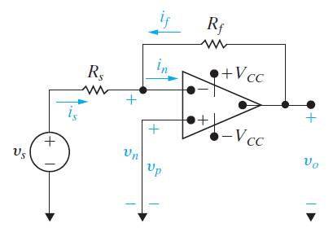
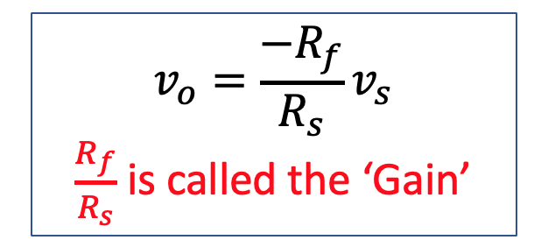
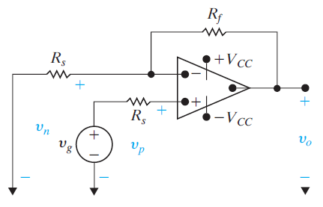
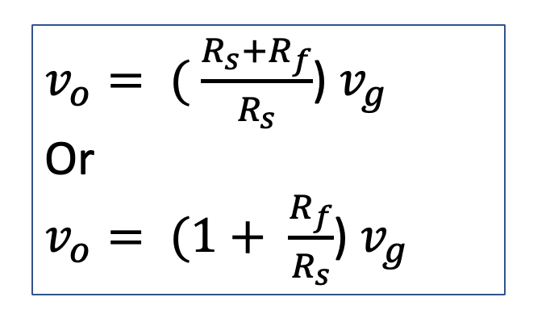
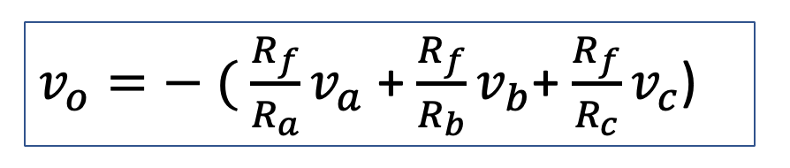
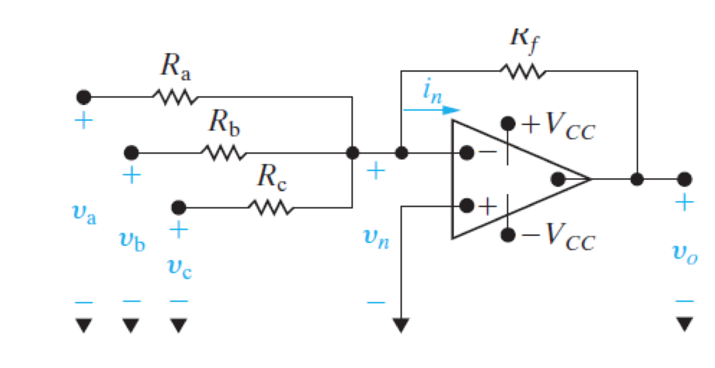
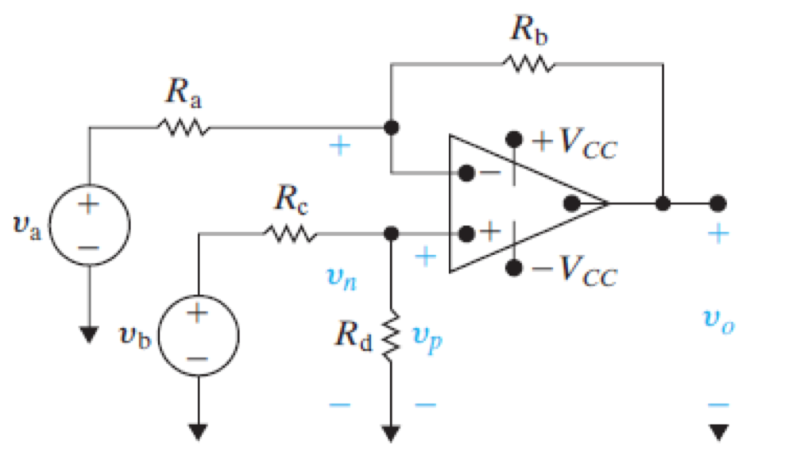
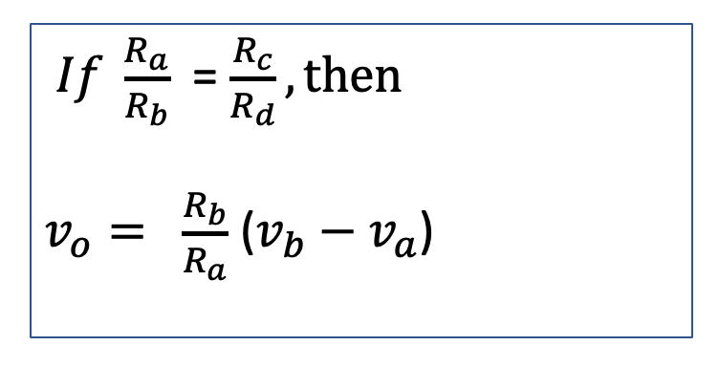
Chapter 5 – Operational Amplifiers
Main ideas:
Op Amp terminals & voltages
Inverting Amplifier
Non Inverting Amplifier
Summing Amplifier
Difference Amplifier
Ideal opamp

Slide 7
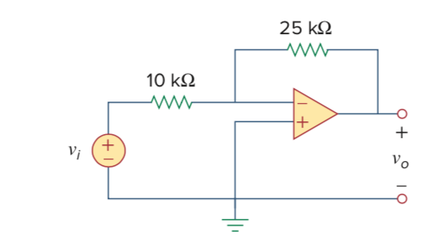
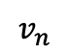
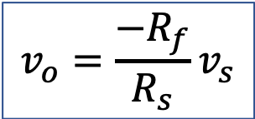
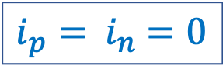
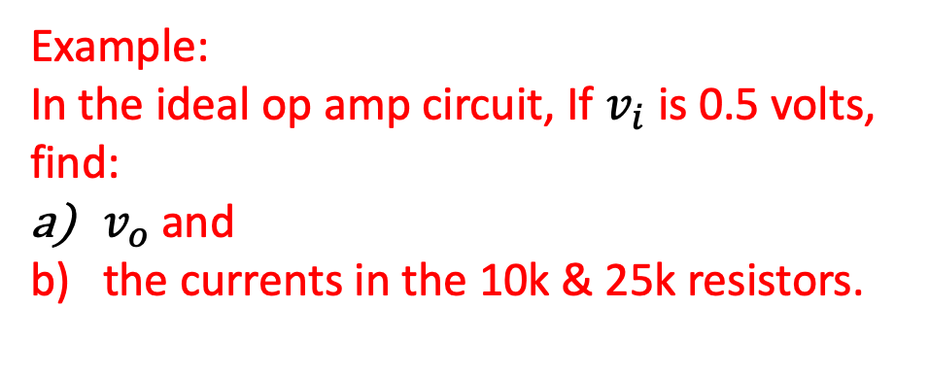

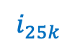
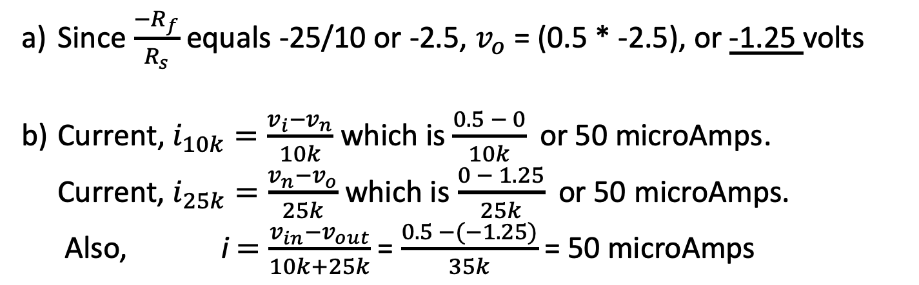
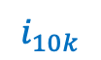
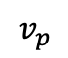
5.3 The Inverting Amplifier Circuit Example
$$i_{25k}$$
Example:
In the ideal op amp circuit, If $v_{i}$ is 0.5 volts, find:
$v_{o}$ and
the currents in the 10k & 25k resistors.
$$i_{10k}$$
$$v_{n}$$
0.5 v
$$v_{p}$$
$$v_{o}=\frac{{−R}_{f}}{R_{s}}v_{s}$$
Since $\frac{{−R}_{f}}{R_{s}}$ equals -25/10 or -2.5, $v_{o}$ = (0.5 * -2.5), or -1.25 volts
Current, $i_{10k}=\frac{{v_{i}−v}_{n}}{10k}$ which is $\frac{0.5 − 0}{10k}$ or 50 microAmps.
Current, $i_{25k}=\frac{{v_{n}−v}_{o}}{25k}$ which is $\frac{0 − 1.25}{25k}$ or 50 microAmps.
Also, i $=\frac{{v_{in}−v}_{out}}{10k+25k}$= $\frac{0.5 −(−1.25)}{35k}$= 50 microAmps
$v_{p}=$ $v_{n}$
$i_{p}=$ $i_{n}$ $=0$

Slide 8
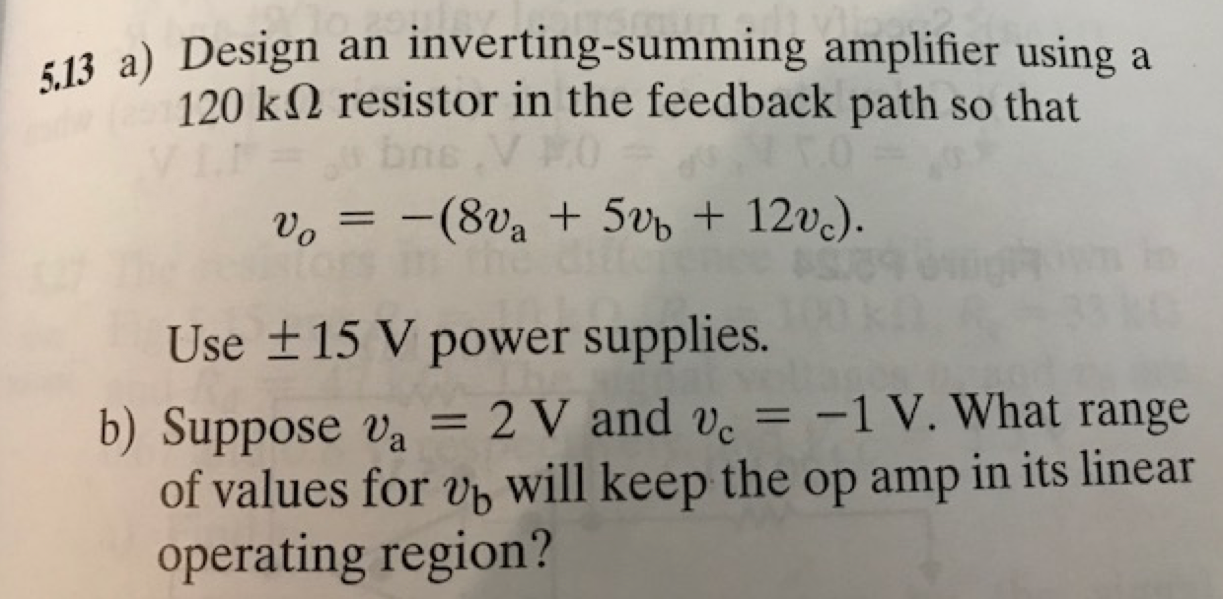
Chapter 5 – Operational Amplifiers
$$v_{n}$$

Slide 9
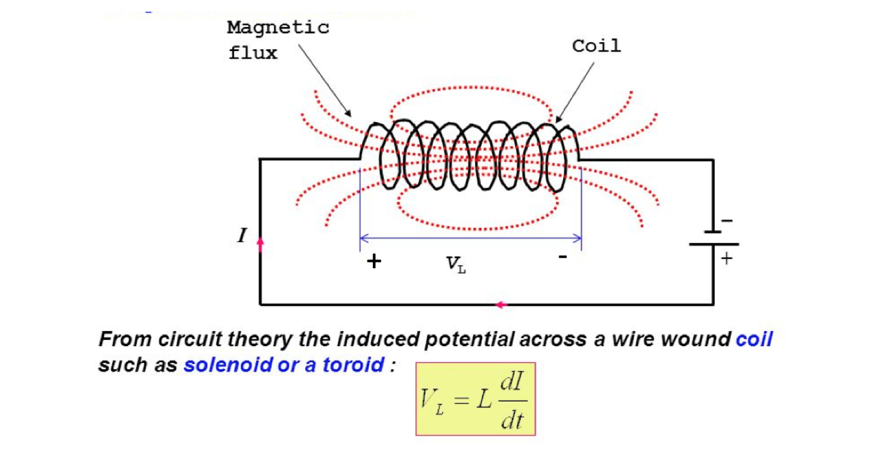
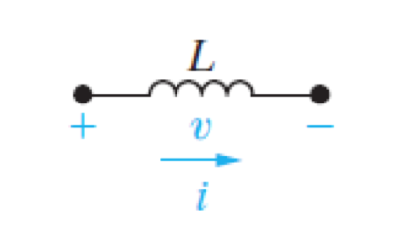
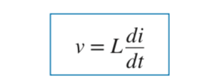
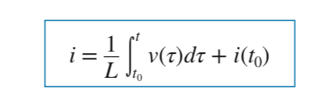
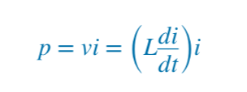
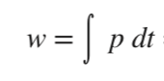
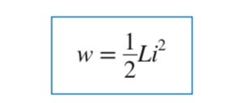
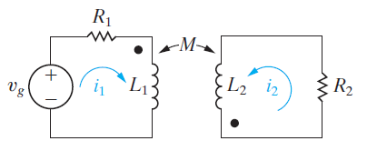
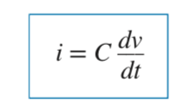
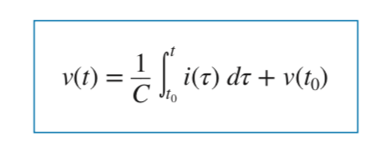
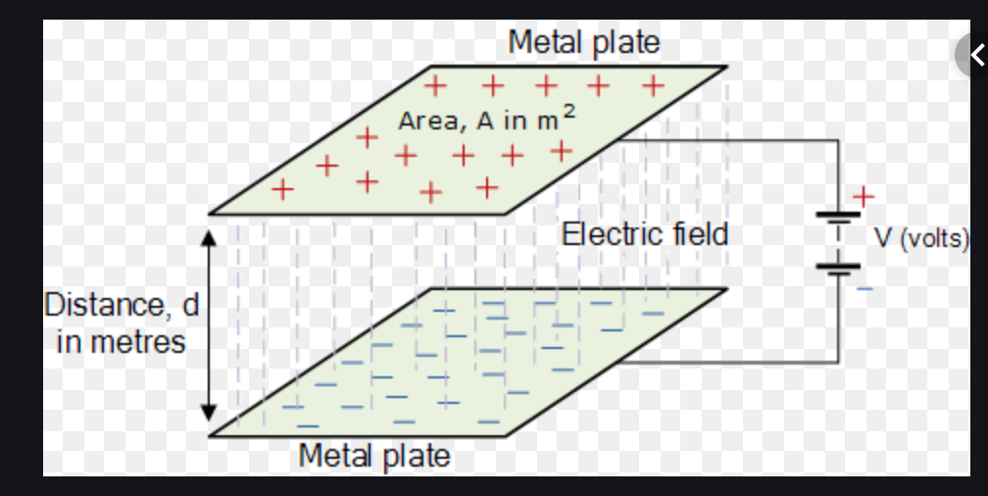
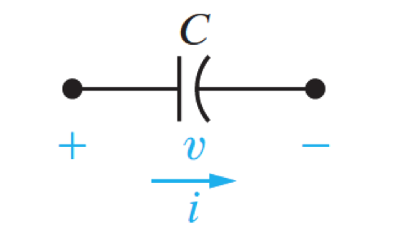
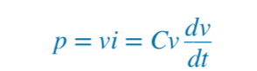
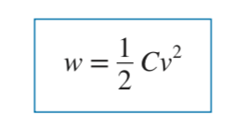
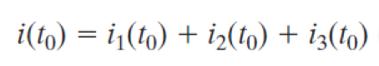
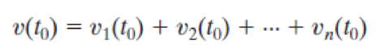




Chapter 6 – Inductance, Capacitance, and Mutual Inductance
Main ideas:
Inductance
Mutual Inductance
Capacitance
Series-Parallel Connections of
Inductors & Capacitors

Slide 10

6.1 The Inductor – Extra Example
a) Find the current through a 5-H inductor, if the voltage across it is:
= 30$t^{2}$ t > 0
$v_{t}$
= 0 t < 0
b) Also, find the find the energy stored at t = 5 Seconds
Assume i(0) = 0

Slide 11




6.2 The Capacitor
Q. Determine the current through a 200- μF capacitor whose voltage is shown
Solution:
i(t)

Slide 12


6.2 Series-Parallel Connections HW Problem 6.24
Problem 6.24
The switch is opened at t = 0.
The resulting voltage is:
v = 2000$e^{−100t}$
Also: $i_{1}\left(0\right)=−6 A \&$ $i_{2}\left(0\right)=1 A$
Find
a)${ i}_{o}\left(0\right)$
b) to d${) i_{o}\left(t\right), i}_{1}\left(t\right), i_{2}\left(t\right)for t≥0$
f) The total energy delivered to the black box
e) The initial energy stored in the inductors
g) The energy trapped in the ideal inductors

